Slide 1
SEM 4 MICRO-PROJECT VIRTUAL PROGRAMING LAB
PROJECT BY:
DSE_01_RHISHIKESH CHAUGHULE
DSE_03_VINAYAK KAPALE
DSE_ANIL SAHU
DSE_SANIKA VIDHATE

Slide 2
ABSTRACT
VPL-Virtual Programming Lab is the easy way to manage programming assignments. Its features of editing, running and evaluation of programs makes learning process for students, and the evaluation task for teachers, easier than ever. Virtual labs is a web development technology. It does not require any additional infrastructural setup for conducting experiments at user premises. The simulations-based experiments can be accessed remotely via internet. This would help students in learning basic and advanced concepts through remote experimentation. VPL is an activity module that manage programming assignments and whose salient features are:
Enable to edit the programs source code in the browser.
Students can run interactively programs in the browser.
Students can test their knowledge through online quiz and assignments.
Even faculty members can do continuous assessment as per defined timeline and get feedback of conducted lab session

Slide 3
INTRODUCTION
The teaching of programming is essential for the development of computer applications and for evolution of technology. The assignments of the early programming courses usually present difficulties for students and need teacher's strong monitoring, for correction and overall orientation towards correct assessment. In this context, virtual learning environment is an important tool on how to teach (and learn) programming, One of these tools is VPL (Virtual Programming Lab) a plug-in developed specifically for Moodle (Modular Object-Oriented Dynamic Learning Environment). This tool allows to edit and execute programs, in a large range of languages, and enables automatic assessment and prompt feedback VPL stores historic results about compilation and implementation of the proposed problems, tracking the student's submissions.

Slide 4
PROBLEM STATEMENT
To develop a centralized system which will help students in their academics, as well as integrate a platform over which students, teachers from all departments can interact with each other for the overall growth of students.

Slide 5
OBJECTIVE OF PROPOSED SYSTEM
To reduce the work of students as they keep on writing manuals which takes ample of time.
The efficient way is after assignments, less effort is required as the student does not need so much attention and assignments grading is much easier using this VPL.

Slide 6
HARDWARE AND SOFTWARE DESIGN
HARDWARE REQUIREMENTS
RAM : 512 MB RAM
Hard Drive : 40 GB Hard Drive
Processor : Intel Core 2 Processor
SOFTWARE REQUIREMENTS
Languages Used:- CSS,HTML
Platform:- Windows 10
The above specified requirements are minimum to run the application.

Slide 7
DESIGN DETAILS:
Functional Requirements:
In functional requirement, we describe the module we require to develop this project. Functional requirements should include functions performed by specific screens, outlines of workflows performed by the system and other business or compliance requirements the system must meet.
Interface Requirements:
Field accepts valid data like in password entry it should be more than 8 character-length
Field accepts numeric data entry
Field only accepts dates before the current date
Security Requirements:
Students, Teachers and Admin can use their own username and password for login.
Admins and teachers can view the the experiments performed by students and can change the introduction related to experiments accordingly

Slide 8
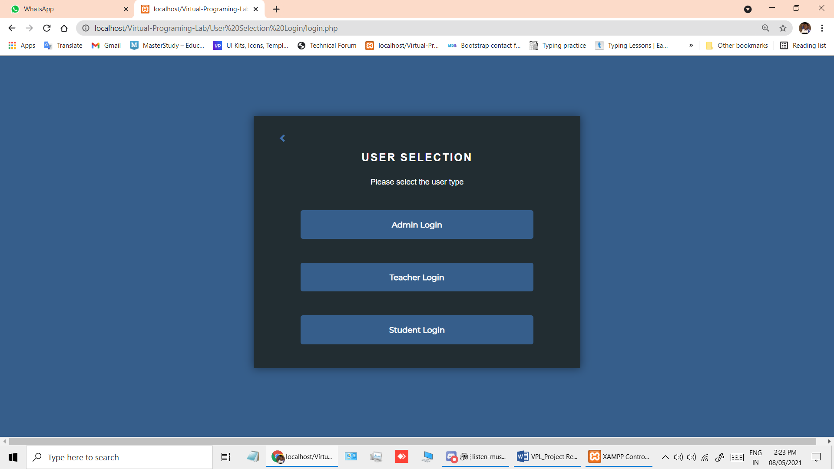
IMPLEMENTATION & RESULT
LOGIN FORM:

Slide 9
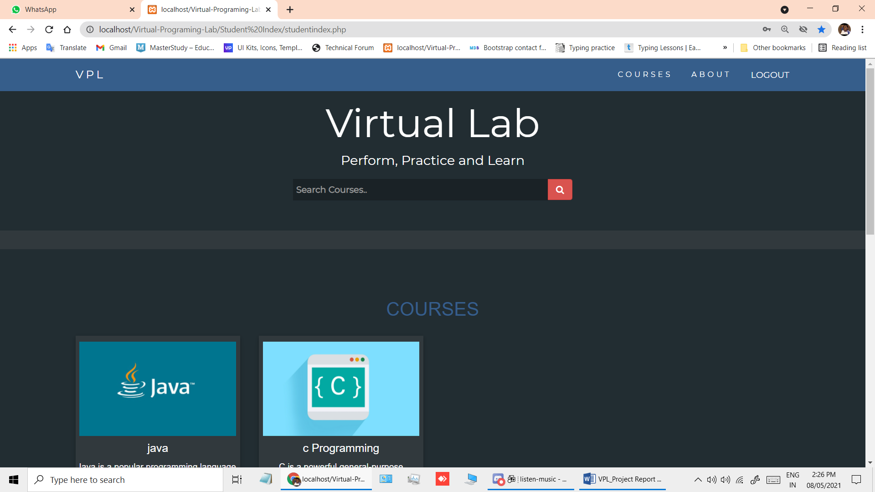
STUDENT HOME PAGE:

Slide 10
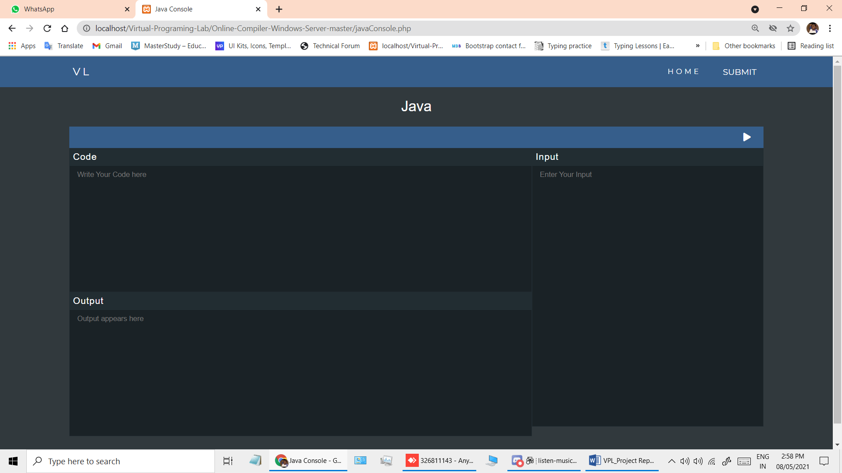
JAVA COMPILER PAGE:

Slide 11
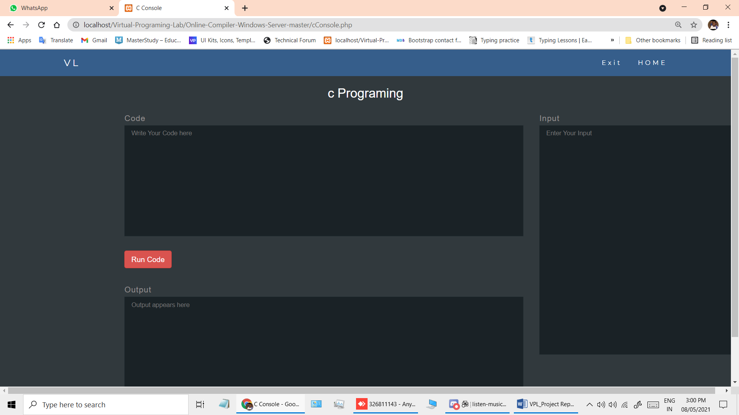
C PROGRAMMING COMPILER:

Slide 12
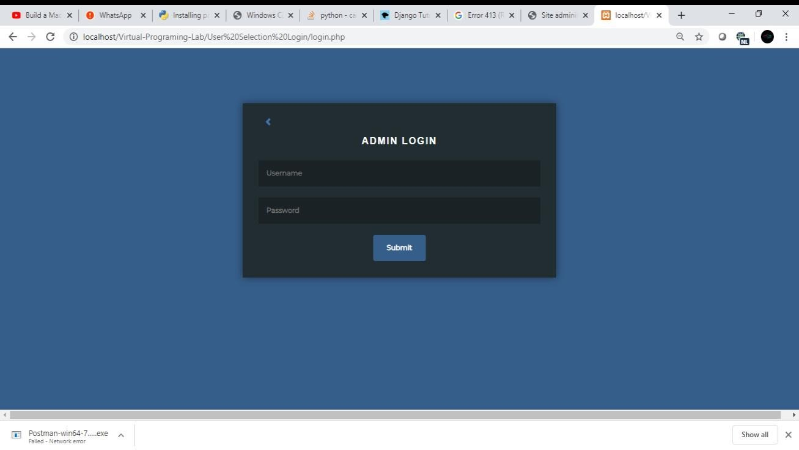
ADMIN LOGIN:

Slide 13
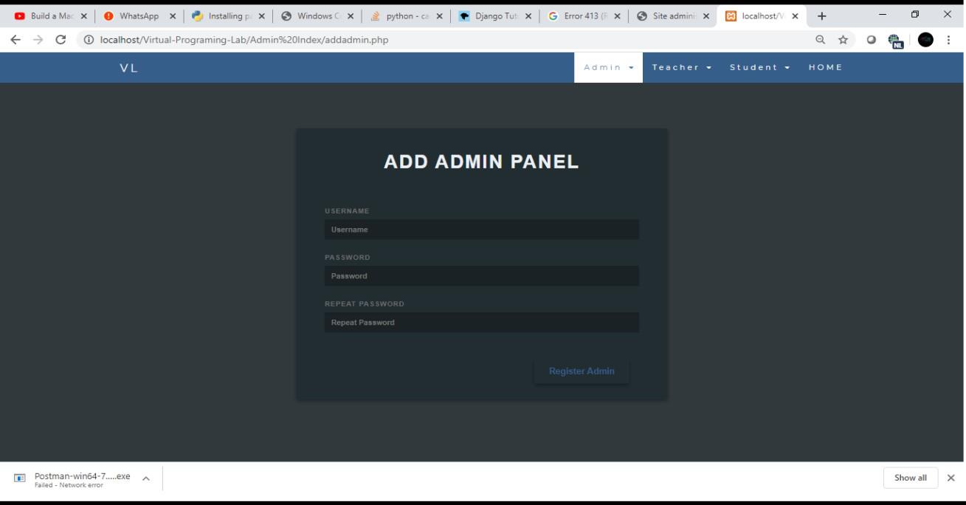
ADMIN PANEL:

Slide 14
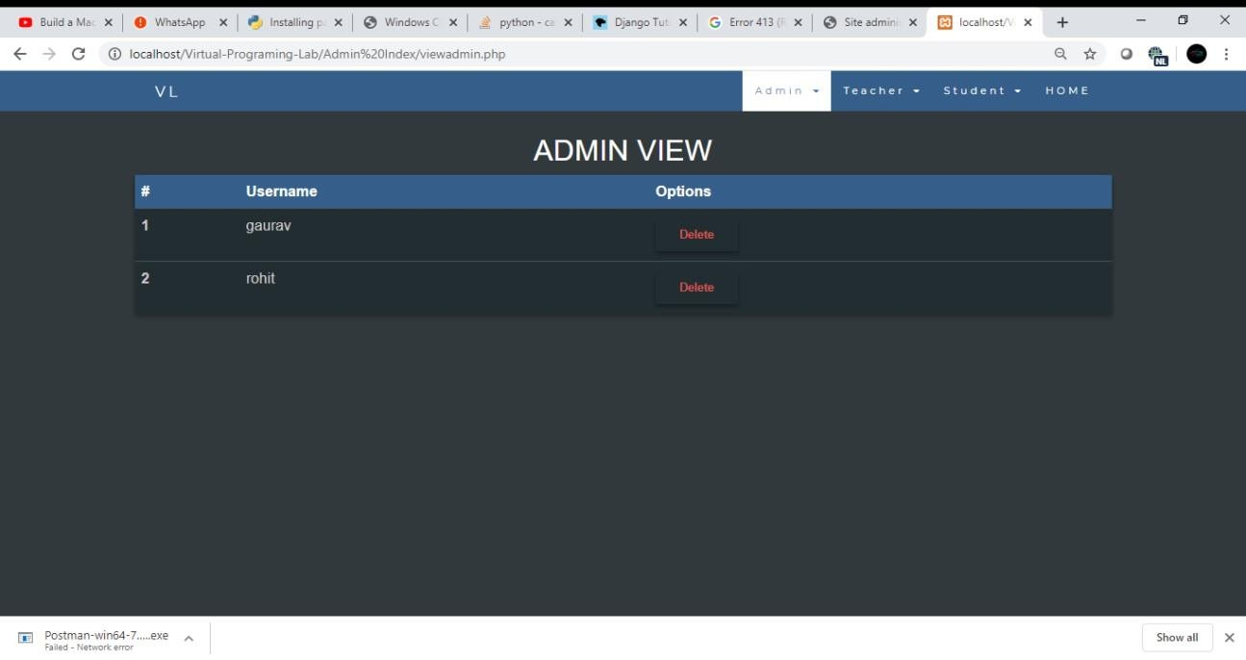

Slide 15
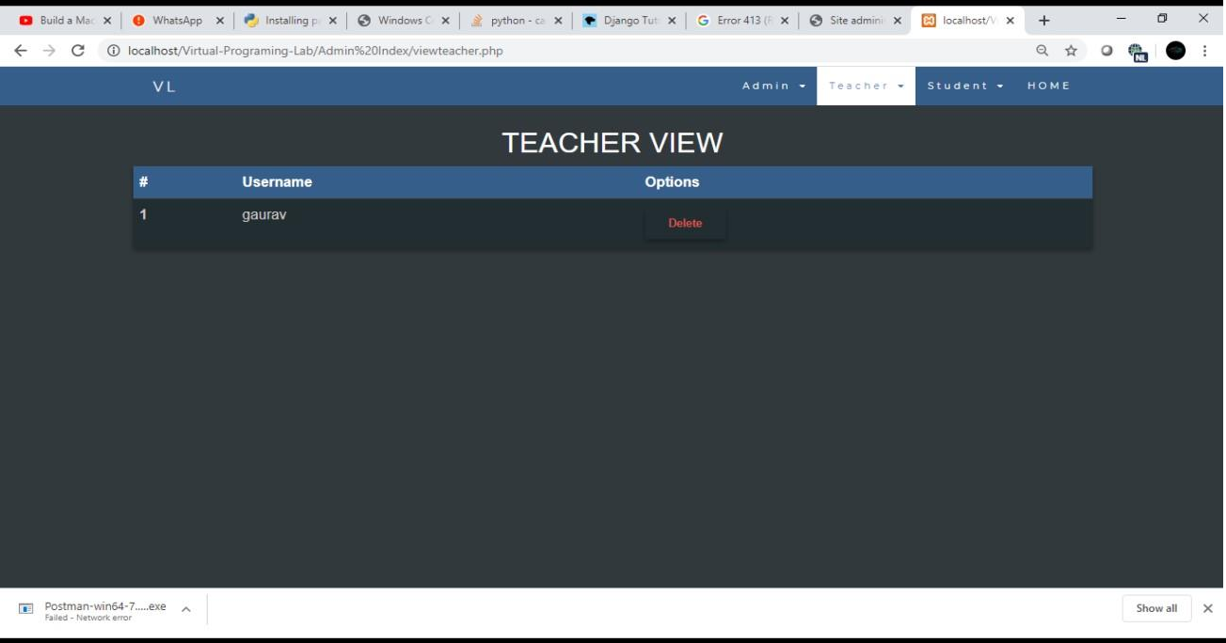
TEACHER PANEL:

Slide 16
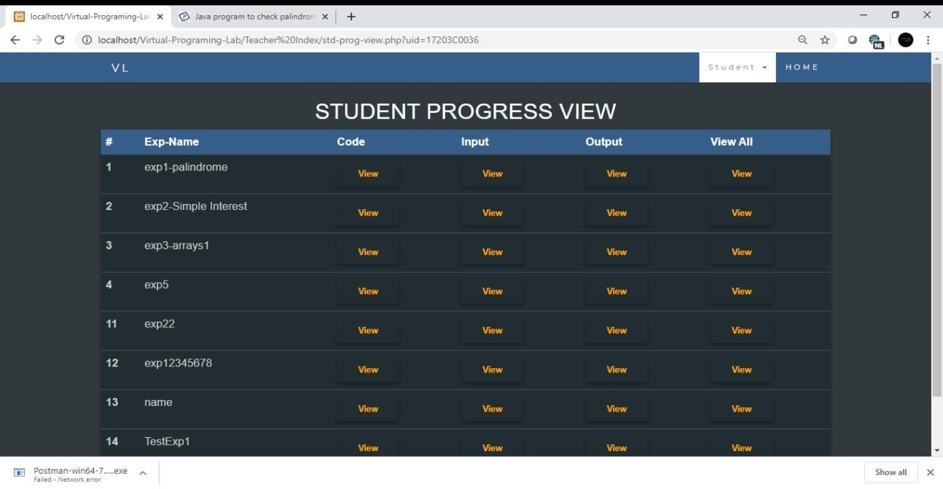

Slide 17
CONCLUSION:
Thus, using these technologies VPL i.e. Virtual Programming Lab was developed for helping students increase their productivity and efficiency.
With the help of VPL it will reduce the work of writing manuals which takes lot of time and also teachers can view the Student Progress.

Slide 18
FUTURE SCOPE:
The student and mainly for the teacher. This is because the teacher must plan its activities accordingly, in order to prepare assignments, configure testing environments, and validation parametrization. These tasks take a lot of time. However, after assignments, less effort is required as the student does not need so much attention and assignments grading are much easier With this system Prospects for all these systems would include to increase their efficiency and to improve their security.

Slide 19
REFERENCES:
https://getbootstrap.com/docs/4.0/examples/
https://codepen.io/? cf_chl_captcha_tk=6dc9d91c30f6b3eee674c1c12c6cdb1796ec 2cd7-1588451736-0- ARNBgooOlwCe7CPgEvWqBNLDVEF35m7IztNyui1QGTrqt6ZBDlYJVB2BDv5mCoxjT- TxwiCScFsyoj5Fs_WPvYDZvmJ60hQ3Rkhd0HXzegcSklF6k89gN5H0vXNHZ3E6UdTu Z4j_6rtSZtumwElUL53D20w949lJRHPmVmXuX3ZfD6bHpFJrAUq3QDlDe- 1cj2LVacUlTl7_fogEa5G3kZzCZJxL- cqH518QU9aUnTmntuZG6M4Fj5cm8xk1DgqQ5yAUS5uVTENfpmLK6biCRMeBW0i748 KLKKfosdqpdVcvfUia7nYRL2b5yCC8Lc1KHGaX0hXJ753xgODEMuDTT8- AFGAS4ORYbM3CdZruPpXyRTOHETJ_G_V9R7G_jAo- 6w1XAwe5LmUKpVtyjMNMwXCQfmyo8j1krIHIz7IR7YVviK8qOlubPPDQ81tFz-5bS- BxXRcXz5bLKPqYBpe2WGjti77TOZDbeYTzYbJ6d7ZxSbUizk5pwBAw05g9XHZ2kXHf 0hqFOy1kcwpfus_jhRc9UcqX8QYDUrC_YP-FkPld

Slide 20
THANK YOU

